Slide 1
Cross validation

Slide 2
What is cross validation:
Cross-validation is a statistical method used to estimate the
performance (or accuracy) of machine learning models.
Cross-validation is a technique in which we train our model using
the subset of the data-set and then evaluate using the complementary
subset of the data-set

Slide 3
Methods of Cross-Validation
1.Validation
2.LOOCV (Leave One Out Cross Validation)
3.K-Fold Cross Validation

Slide 4
1.validation:
In validation we perform training on the 50% of the given data
Set and rest 50% is used for the testing purpose.
The major drawback of this method is that we perform training
on the 50% of the dataset, it may possible that the remaining 50%
of the data contains some important information which we are
leaving while training our model .
In this bias will be higher.

Slide 5
Loocv (leave one out cross validation):
In this method, we perform training on the whole data-set but leaves only one data-point of the available data-set and then iterates for each data-point
The major drawback of this method is that it leads to higher variation in the testing model as we are testing against one data point. Another drawback is it takes a lot of execution time as it iterates over ‘the number of data points’ (n) times

Slide 6
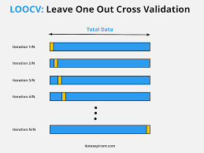

Slide 7
3.K-Fold Cross Validation:
In this method, we split the data-set into k number of subsets
(known as folds) then we perform training on the all the subsets
but leave one(k-1) subset for the evaluation of the trained model.
In this method, we iterate k times with a different subset reserved
for testing purpose each time.

Slide 8
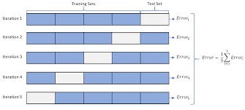

Slide 9
Advantages:
1.This runs K times faster than Leave One Out cross-validation
because K-fold cross-validation repeats the train/test split K-times.
2. It is more accurate.
3. More “efficient” use of data as every observation is used for both
training and testing.

Slide 10
Thank you

